Slide 1


INSTAGRAM USER ANALYTICS
Using SQL Fundamentals

Slide 2
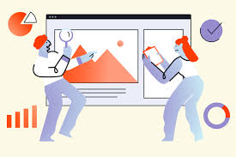
ABOUT THE PROJECT
In order to get business insights for better marketing and product, we track how consumers connect and interact with our digital product.
This phenomenon is known as User Analysis.
These business insights are used by various teams to launch new marketing crusade, improving the product as per user engagement and improving the overall experience with room for business growth.
User Analysis is what we ought to do in this project.
With the Data provided on Instagram users, analysis on various user trends and behaviors was to be done.
Various tasks were given to find such behavior
Some of those given tasks were;
to find the 5 oldest users
Finding bots
Most used tags; and so on.

Slide 3

APPROACH USED FOR THE PROJECT
Among the various approaches for the project work, the traditional one was used for this project.
The project went through stages of project lifecycle(explained in the traditional approach): Initiation, planning, execution , monitor and project closing.
Going by this approach, the project work was very smooth.
Initiation of project was understanding the user analysis, planning done included which RDBMS to be used and such factors and execution went on smoothly with SQL and PowerPoint.
Monitoring and Project closing is to be done after the completion of this presentation(As this presentation is part of execution).

Slide 4


TECH-STACK USED
The software used for the Instagram user Analytics was MySQL Workbench version 8.0.33.
Also, MS PowerPoint helped in putting up a presentation of the project work.
MySQL is basically quicker and more efficient than other relational database management systems.
Above is the reason of using MySQL over other RDBMS for this project.

Slide 5
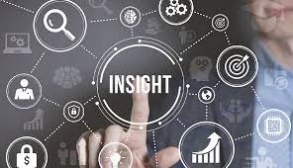

INSIGHTS(for the Marketing Campaign)
Username | Date
Darby_Herzog | 2016-05-06
Emilio_Bernier52 | 2016-05-06
Elenor88 | 2016-05-08
Nicole71 | 2016-05-09
Jordyn.Jacobson2 | 2016-05-14
First initiative was to reward the most loyal users of Instagram by finding the five oldest users of Instagram from the given data.
The long term users of Insta were to be rewarded in the first initiative.
This initiative is a progressive one influencing the users and non-users of Instagram in the good will of the digital platform.
The table shown provides the list of the oldest users and their date of joining the platform.
Changes can be made to the extent of people rewarded; More active users can also be included in the reward.

Slide 6
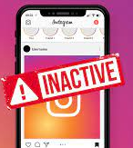
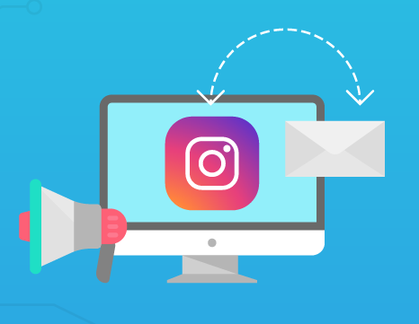
INSIGHTS(for the Marketing Campaign)
Darby_Herzog | Ollie_Ledner37
Esther.Zulauf61 | Mckenna17
Bartholome.Bernhard | David.Osinski47
Jessyca_West | Morgan.Kassulke
Esmeralda.Mraz57 | Linnea59
Bethany20 | Duane60
Next Initiative was to wake up the inactive users( who had zero posts) by sending them promotional emails to post their first photo
The Given list is the list of users who have zero posts and are basically inactive on Insta.
These are to be sent promotional emails for posting pictures on the platform.
Inference is that, this initiative can influence inactive users but also changes can be made on their Insta dashboard for posting and the users can also be increased for promoting even better and broader.
Julien_Schmidt | Aniya_Hackett
Mike.Auer39 | Kasandra_Homenick
Franco_Keebler64 | Jaclyn81
Nia_Haag | Rocio33
Hulda.Macejkovic | Maxwell.Halvorson
Leslie67 | Tierra.Trantow
Janelle.Nikolaus81 | Pearl7

Slide 7

INSIGHTS(for the Marketing Campaign)
A contest was conducted by the team, in which the user who got the most likes on a single photo would be the winner.
In the data provided, the user with most likes on a photo(which were 48) was Zack_Kemmer93.
Inference is that , contest will be fruitful in better marketing of the platform and No such changes are recommended.
Zack_Kemmer93

Slide 8

INSIGHTS(for the Marketing Campaign)
For the knowledge of a partner brand(who wanted to know which hashtags to use for reaching maximum people), we were to find the most commonly used hashtags on Instagram.
The graph shows the most used tags and also the amount of times they have been used.
Inference is that, most people are all about enjoying in the posts on Instagram.
Partner brand is recommended to focus on the joyous aspect of people and not just about the tags used.

Slide 9
INSIGHTS(for the Marketing Campaign)
Day | Times
Saturday | 14
Sunday | 14
Monday | 13
Tuesday | 16
Wednesday | 15
Thursday | 12
Friday | 16
For the best knowledge of the team, for fixing a day to launch Ads, the week day on which the most users registered was to be found.
The given graph shows how Tuesday and Friday are the days on which most users registered, followed by Wednesday , Saturday and Sunday.
Inference is obvious that people ought to register more on Tuesdays and Fridays(i.e. they look for new things on those days) but the team can also look forward to the days with 2nd and 3rd position as per their schedule.

Slide 10
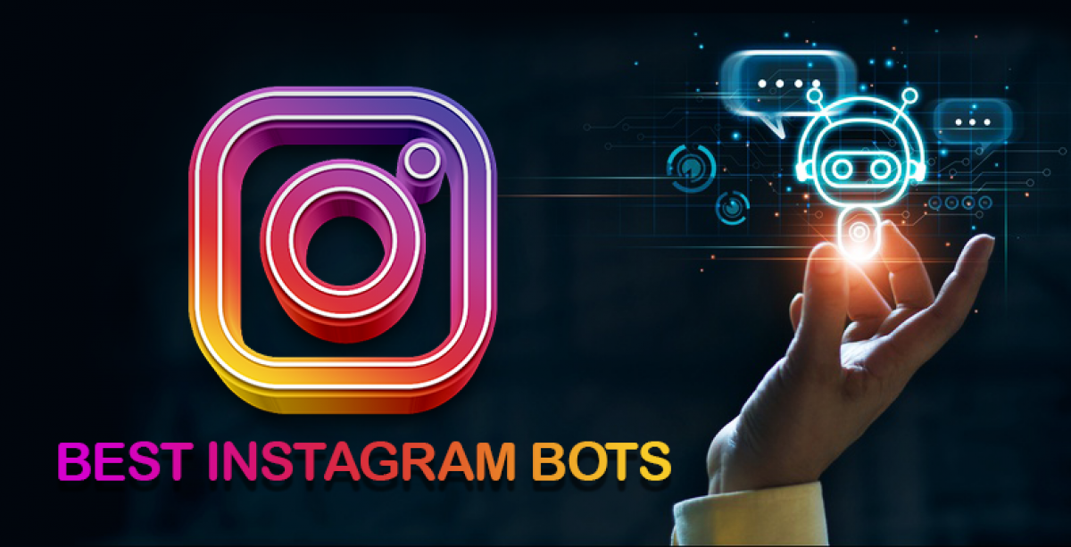
INSIGHTS(for the Investor Metrics)
Rocio33
Nia_Haag
Aniya_Hackett
Mike.Auer39
Mckenna17
Jaclyn81
Julien_Schmidt
Maxwell.Halvorson
Janelle.Nikolaus81
Leslie67
Duane60
Bethany20
Ollie_Ledner37
The investors had demanded to know if the platform is overcrowded with fake and dummy accounts.
For this the people who had liked every single photo in Instagram were to be found.
The table shows the users who had liked all photos in the given data(257- all photos).
Inference is that either they are fake accounts or bots of a kind. They can be eliminated and investors can be reassured that the platform has very less quantity of bots which can be worked upon.

Slide 11
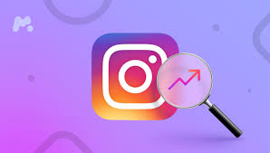
INSIGHTS(for the Investor Metrics)
The investors wanted to know user engagement on platform is appropriate or not.
For this the data was shuffled and times an average user posts on Insta was calculated.
Also the ratio of total photos and total users was also put up.
An average user posted 3.5 times on the platform. And the ratio of total photos and total users is 2.5.
This infers that inactive users have zero posts and also investors can be notified that marketing team is working on this aspect
Times an average user posts | Ratio of Total photos and Total users
3.5 | 2.5

Slide 12
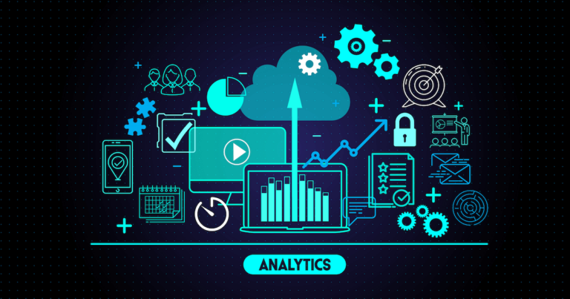
RESULT
While making this project, I gained knowledge about SQL, and more and more aspects of PowerPoint.
Not only this , I learnt about data handling and User behavior as Instagram is one platform where different users connect and operate.
This project helped in me understand the work of analytics, how do we proceed with the stages of analytics and so on.
This project was an Insight on how a Data Analyst works

